Slide 1
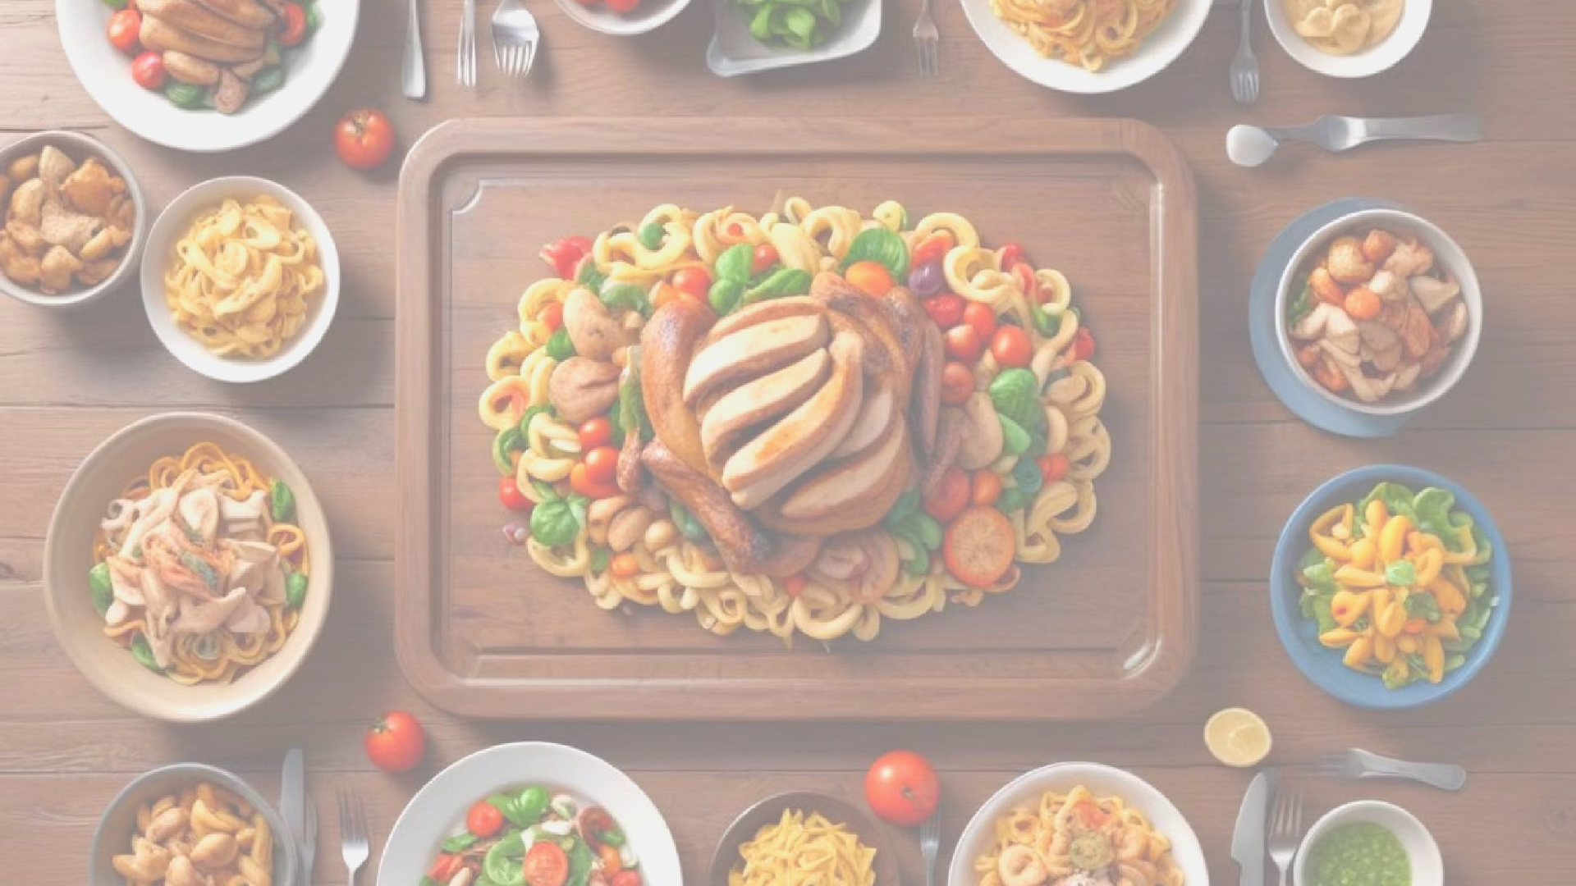
Recipe Recommender Assignment EDA
By :
Niket. Talikoti

Slide 2

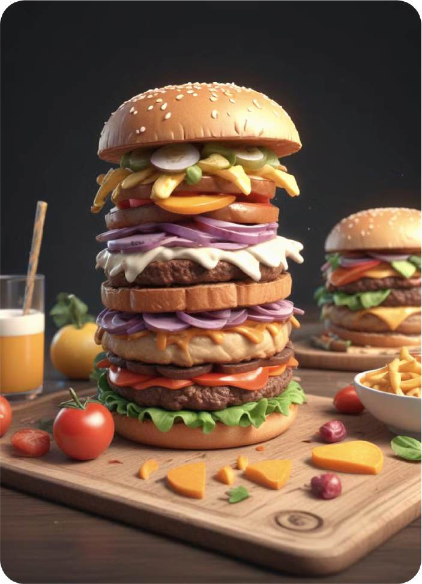
Problem Statement
Step into the shoes of an ML engineer working at food.com. Your job is to design a recommender system to recommend recipes to users based on their choice and the current recipe they are looking at.
The recommendation engine is a way to increase the website's user engagement. If a user is shown relevant recipes, they are more likely to spend more time on your site reading about recipes. Higher user engagement will likely result in more business opportunities like collaborations, promotions, etc.
The performance of a recommendation engine will significantly impact the revenue your recipe site can generate.
Designing a recommender from scratch is a time-consuming task. In this assignment, you are expected to explore the data and create features that will be used to build the recommender.

Slide 3
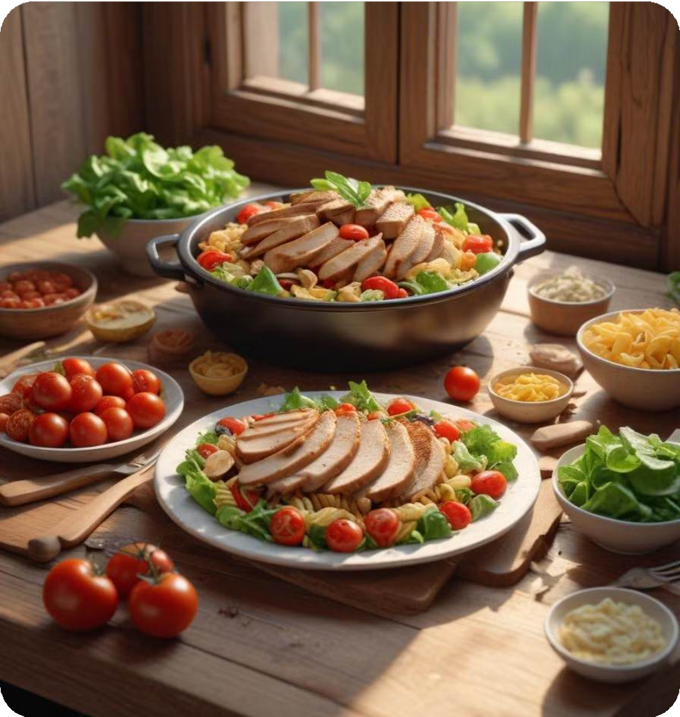

Purpose of Analysis
This assignment is to perform Exploratory Data Analysis and feature extraction from the raw data.
We used Spark on the Elastic Map Reduce service (EMR).
The recommendation engine is a way to increase the website's user engagement. If a user is shown relevant recipes, they are more likely to spend more time on your site reading about recipes.
Higher user engagement will likely result in more business
opportunities like collaborations, promotions, etc.

Slide 4


What we have for analysis?
Read the data
Extract individual features from the nutrition column.
Standardize the nutrition values.
Convert the tags column from a string to an array of strings.
Read the second data file .
Create time-based features.

Slide 5

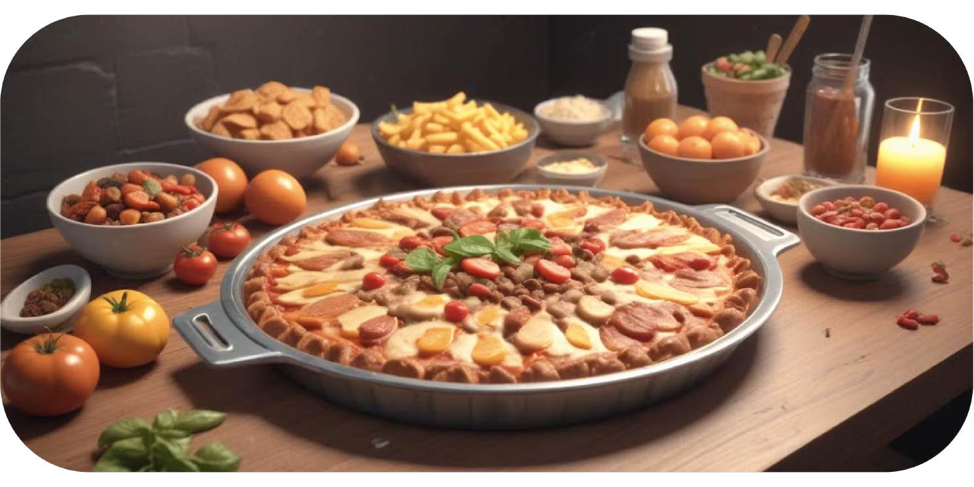
Steps to follow
There are two major datasheets in CSV file.
The first approach to EDA is to cover all possibilities for all columns.
The second approach is project-specific.
To perform program we require PySpark, jupyter Notebook and libraries as Pandas, Numpy, seaborn, matplotlib, sklearn, statmodels.api, and warnings etc.

Slide 6
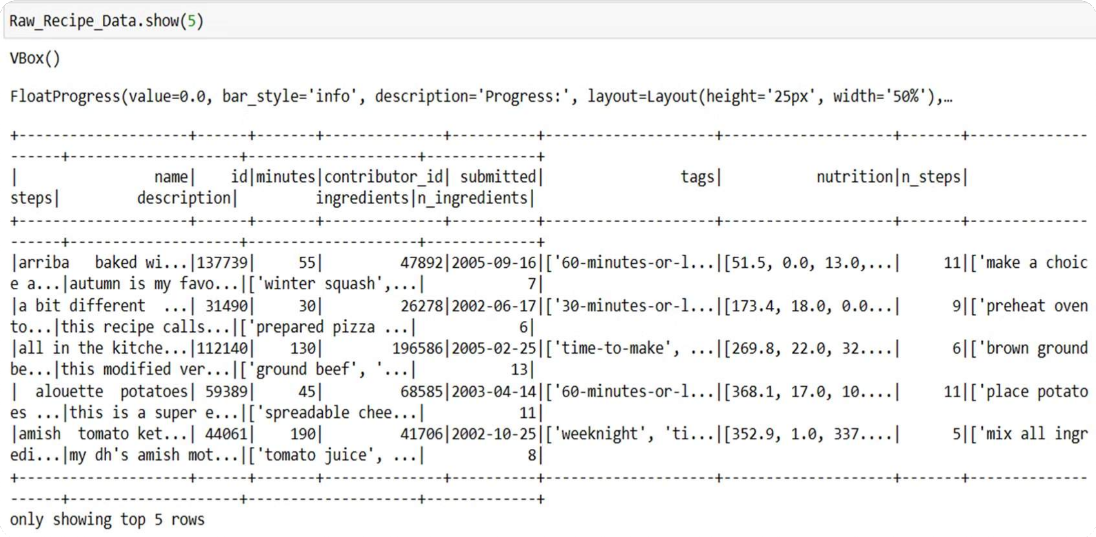
Step 1: Read The Data

Slide 7
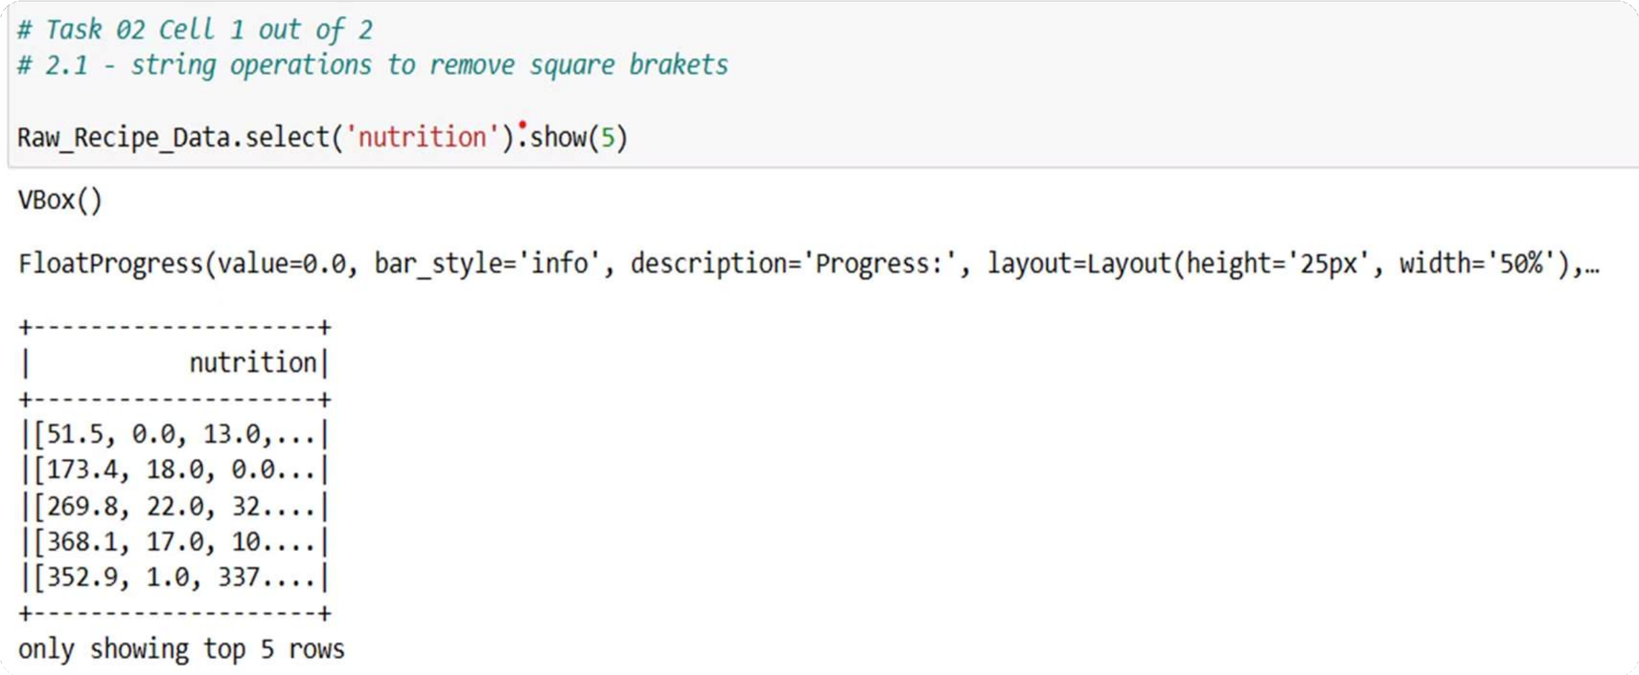
Extract individual features from the nutrition column.

Slide 8
Standardize the nutrition values.
Sample Calculation
Before transformation: sugar (PDV) for recipe id 137739 = 13.0
Calories in the recipe id 137739 = 51.5 uCalculation:
sugar_per_100_cal = 13.0 * 100 / 51.5
After transformation sugar_per_100_cal = 25.24

Slide 9

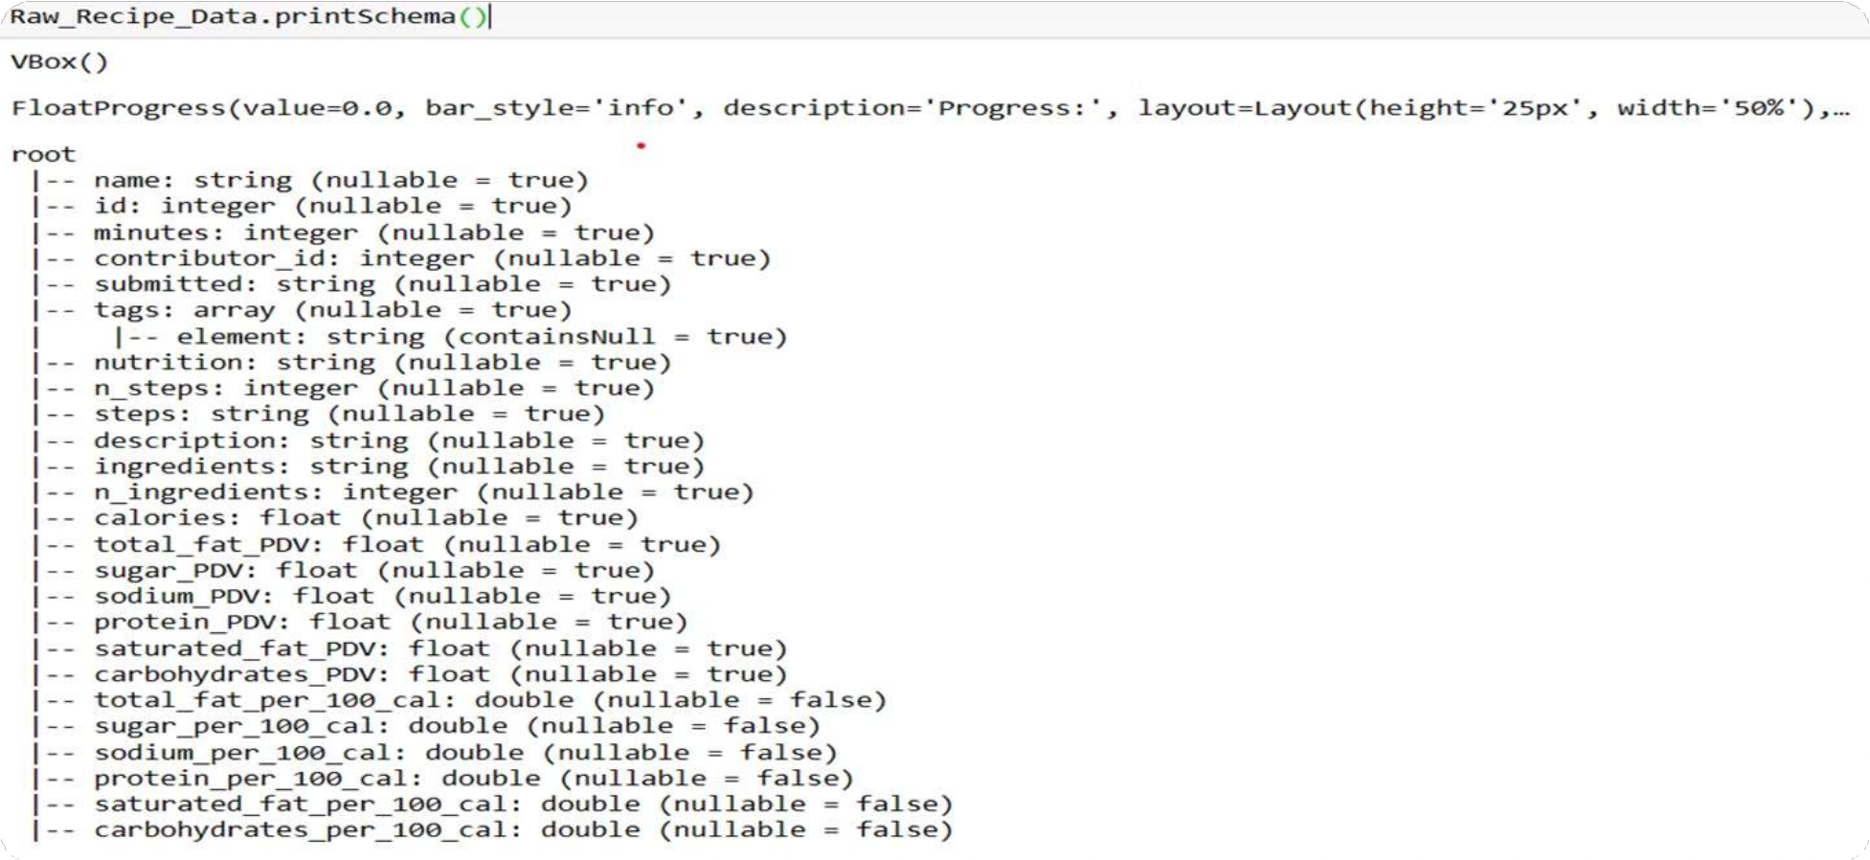
Convert the tags column from a string to an array of strings.
Raw_Recipe_Data = (Raw_Recipe_Data
.withColumn('tags', F.regexp_replace("tags","[ \[ \] \']",""))
.withColumn('tags', F.split("tags",", "))
)

Slide 10
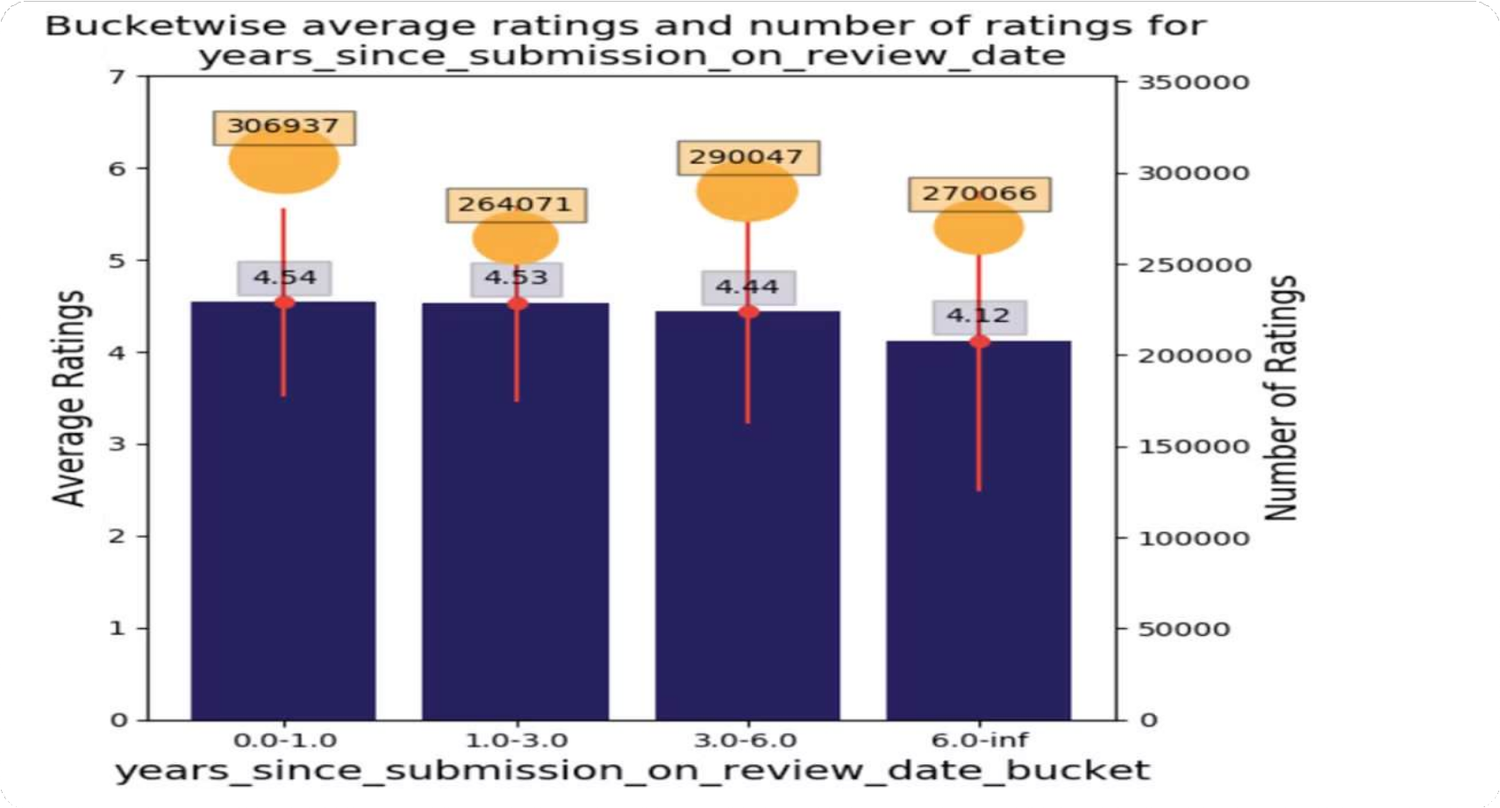
Bucketing and Cleaning Numerical Features

Slide 11
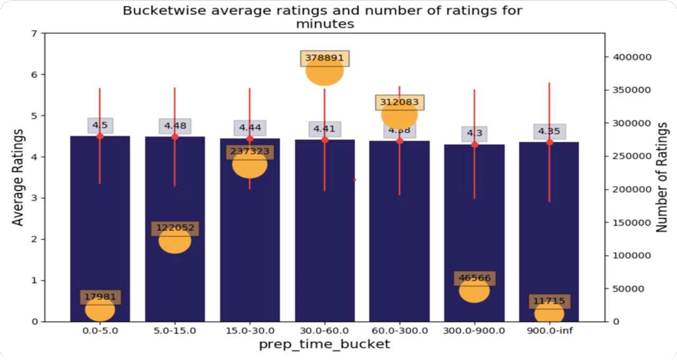
Bucketwise average ratings and number of ratings got minutes

Slide 12
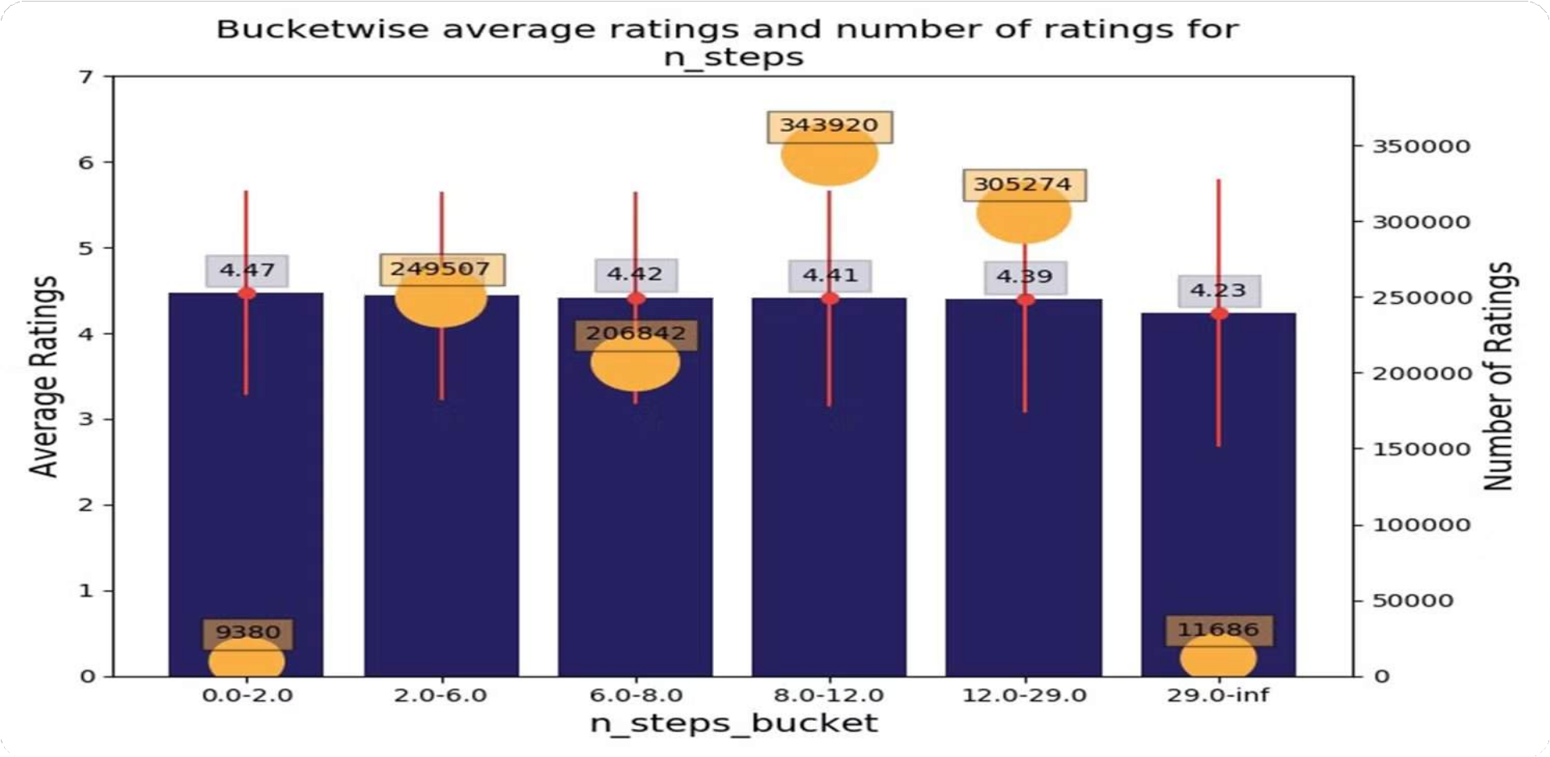
Bucket wise average ratings and number of ratings for n_steps

Slide 13
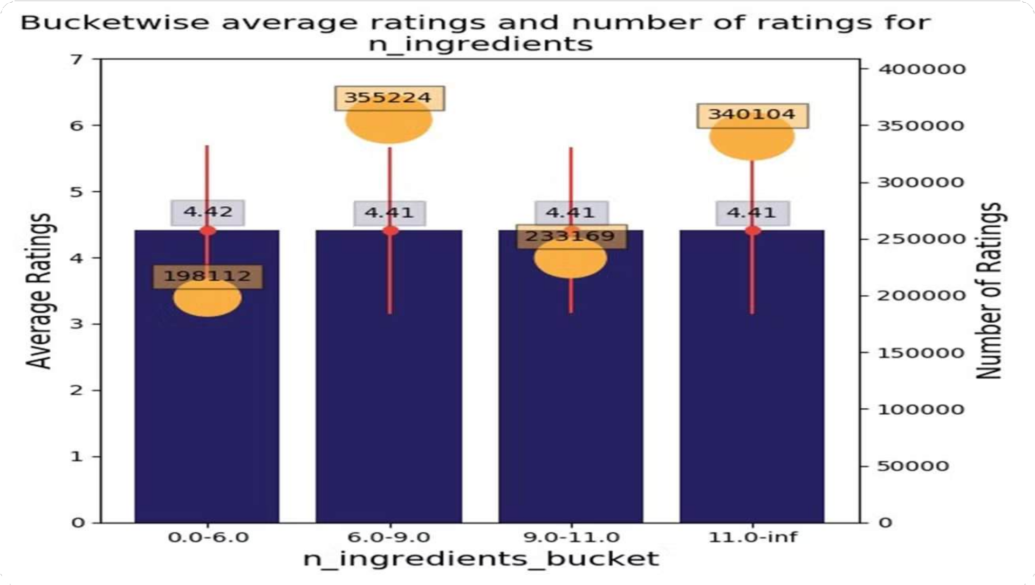
Bucket wise average ratings and number of ratings for n_ingredients

Slide 14

Conclusion
A successful recommender system can increase user engagement and lead to more business opportunities.
The performance of the recommendation engine will directly impact the revenue generated by the website.
Task is to design a recommender system that suggests recipes to users based on their choices and the recipe they are currently viewing.
However, building a recommender from scratch is time-consuming.

